Slide 1
EE188L EE I Laboratory
Lab # 02 - Diodes,
DC Power Supplies

Slide 2
Lab XX Learning Outcomes
At the end of this lab you will be able to:
Understand basic diode voltage and current characteristics
Use the diode as a voltage-controlled switch
Build a bridge full wave rectifier that produces a DC signal out of an AC signal
Measure AC RMS voltages and measure True RMS voltages for AC+DC mixed signals
Use a function generator to produce an AC sinusoidal waveform

Slide 3
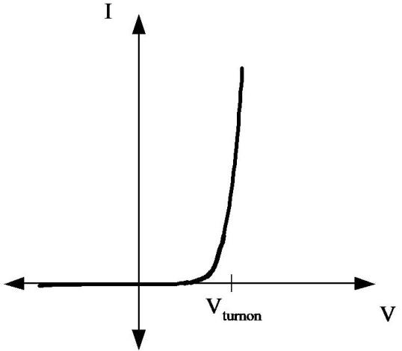
Background – Diode I-V Characteristic
A diode has a fairly simple relationship between current and voltage, as shown below.
The diode conducts no current and acts like a switch in the off position until the voltage across the diode reaches the turn-on voltage, then it begins acting like a switch in the “on” position.

Slide 4
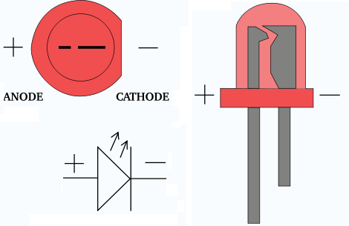
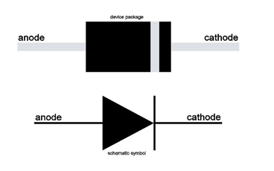
Identifying Cathode(-) and Anode(+)
LED – light emitting diode
Regular diode

Slide 5
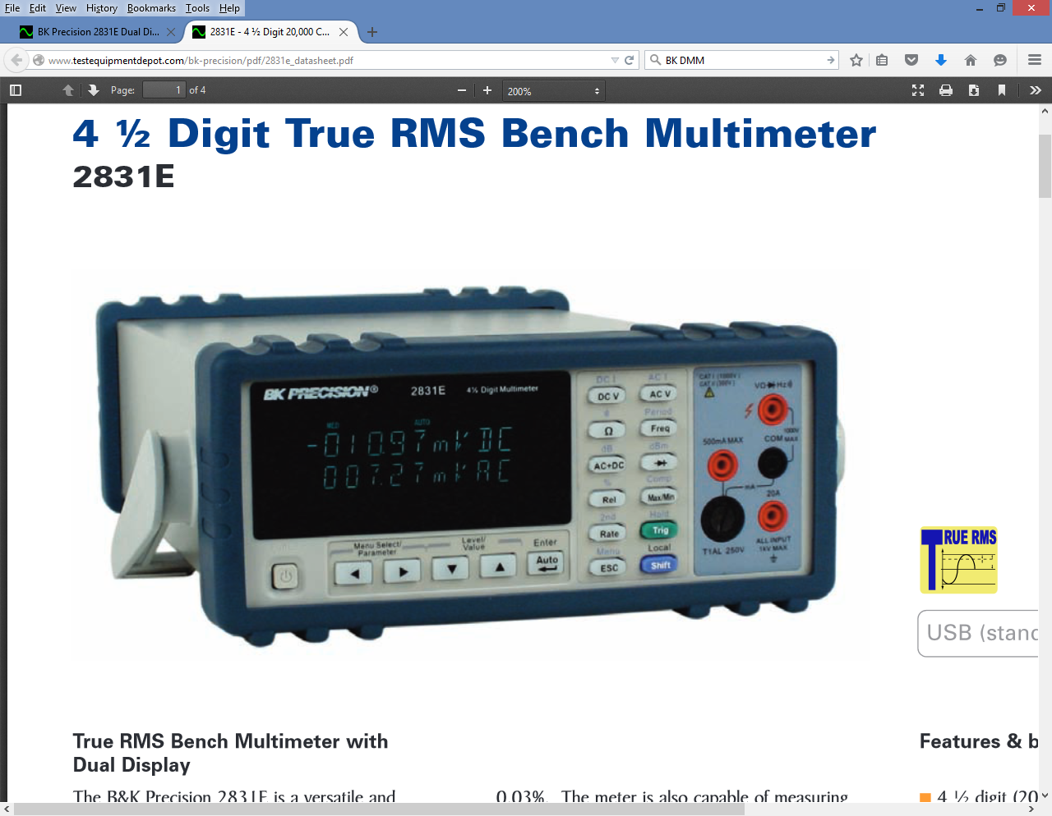
Activity #1 – Diode Testing
The Digital Multimeter is used to check a diode and determine its turn-on voltage and it’s direction.
Press the diode test button & place the red probe on the “+” side and the black probe on the “-” side to measure the turn-on voltage.

Slide 6
Getting the Diode in the Right Direction
When you measure a turn-on voltage with the DMM probes, then the red probe is on the anode or + lead of the diode
Current only flows from + to -

Slide 7
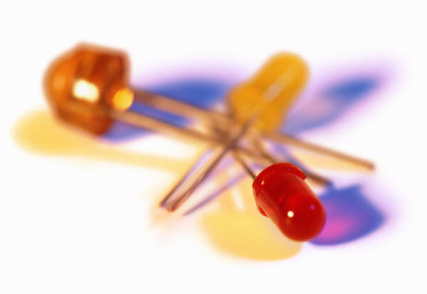
Activity #1 – Light Emitting Diodes
LEDs are diodes that
also emit colored light
when current is flowing
(most other diodes produce heat)
The DMM diode test will show that LEDs have a higher turn-on voltage than regular diodes

Slide 8
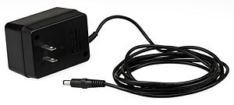
Activity #2 – DC Power Supplies
Diodes are a key element in circuits where you want to block the current flow in one direction, like when you convert AC power to DC power.
For every product that has electronics, a DC power supply must change AC to DC to power the electronics. Usually there is also a transformer to step the voltage level down to just a few volts.
All electronic devices need
DC power to operate, but
most products are powered by AC power.

Slide 9
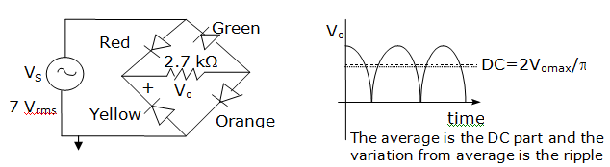
Activity #2 – Full Wave Rectification
A crude AC to DC converter uses 4 diodes to produce a mixed (AC+DC) signal with a positive average or DC value, When Vs > turn-on V, current flows as shown:

Slide 10
Activity #2 – Full Wave Rectification
LEDs are used to see how the circuit works with 2 diodes conducting at a time so that the current always goes through the load resistor in the same direction, so Vo>0. When Vs<0, current flows as shown in blue:

Slide 11
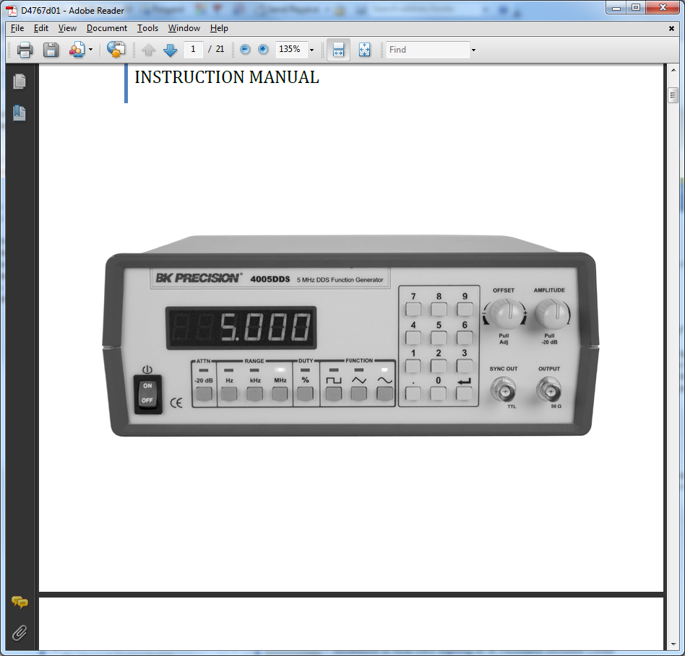
Function Generator
Range is set automatically
Frequency Display
Frequency Setting
Output
Freq. Range
Type of Waveform
Adjust Output Level
Select the type of waveform & frequency range you want
Use the keypad to set the frequency to the selected range
Adjust the output voltage level using the amplitude knob

Slide 12
Function Generator
Range is set automatically
Press for -20 dB
Pull Out for -20 dB
Press the ATTN (Attenuation) button to get smaller amplitudes (-20 dB or a factor of 1/10th). Additionally, you can pull out the Amplitude Knob to get the same effect (or both to get -40 dB or a factor of 1/100th). For this lab, make sure there is no attenuation!

Slide 13
Function Generator
Range is set automatically
Pull Out to create a mixed AC+DC signal
For this lab, make sure it is pressed in!
Use a coaxial cable with a BNC connector (hanging
near the doors) to connect the function generator
output to the circuit

Slide 14
Tips on Making Your Circuit
Set the AC voltage produced by the function generator to between 5-7 Volts RMS, by measuring with the DMM
Make sure the DC offset button on the function generator is not pulled out. You can check this by measuring the DC voltage produced by the function generator to see that it is nearly zero
Make sure the amplitude knob is not pulled out and the ATTN button is not lit

Slide 15
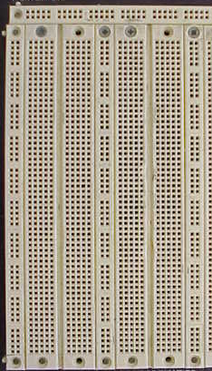
Circuit #1
The output is measured
across the resistor
BK 4005
Function Generator
green
red
+ Vo -
2.7 KΩ
yellow
orange
The resistor’s left side is
connected to the – terminals
of the red and yellow diodes.
The resistor’s right side is
connected to the + terminals of
the green and orange diodes

Slide 16
Making the Measurements
Use 1 KHz rather than 1 MHz for your frequency since some function generators may not be able to deliver enough voltage at high frequencies.
Press the sinusoidal function button
Press the kHz button
Press the 1 on the keypad and return
Connect the DMM to the function generator output and adjust the amplitude to 5-7 V AC while measuring the AC V (RMS) voltage

Slide 17
Measuring AC and DC Voltage
Press the DC V button (circled in red) to measure the DC portion of the mixed AC+DC signal.
Use the AC V button (circled in blue) to find the RMS value of the AC portion.

Slide 18
True RMS Values
Any signal, like your full wave rectified signal, may have both a DC component and an AC component (or ripple)
True RMS allows you to determine an equivalent DC voltage that would produce the same power as the mixed signal

Slide 19
Measuring True RMS
Press the AC+DC button (circled in green) to measure the RMS value of the mixed AC+DC signal.

Slide 20
Activity #2 – Procedure
Measure the AC RMS voltage output of the function generator when at 1 KHz
Lower the frequency on the function generator to 1 Hz (press the Hz range button)
Record which diodes light at the same time
Raise the frequency back to 1 KHz (press the KHz range button)
Measure the DC V portion, the AC V (RMS) portion and the AC+DC (True RMS) values
Calculate the expected AC+DC (True RMS) value using the formula for True RMS

Slide 21
Activity #2 – Expected Results
You should see the red and orange LED’s on at the same time, then the green and yellow lighting together, if your circuit is working properly
Your DC voltage should be 3 to 5.5 volts
Your AC voltage should be 1.5-3.0 volts

Slide 22
Add Capacitor
BK 4005
Function Generator
green
red
+ Vo -
yellow
orange
The capacitor is shown in
purple and is in parallel to
the resistor.
The output is still across the
resistor (and capacitor now)

Slide 23
With Capacitor – Expected Results
Your DC voltage should be nearly as high as your True RMS value was without the capacitor
Your AC voltage should be much smaller and in the millivolt range
The capacitor stores energy and holds the DC voltage up when before it returned to zero. This produces a higher DC voltage and a lower AC voltage

Slide 24
Full Wave Rectifier using a Transformer
A transformer is often used to reduce the relatively high AC voltages down to low DC voltages. A transformer and two diodes can be used to produce the same full wave rectified waveform as before.

Slide 25
Filtered Full Wave Rectifier
A silicon diode with a smaller turn-on voltage is usually used to increase the average value (since less voltage is lost across the diode)
A voltage regulator IC is also used to pinpoint the voltage and reduce the AC variation to practically nothing

